Slide 1
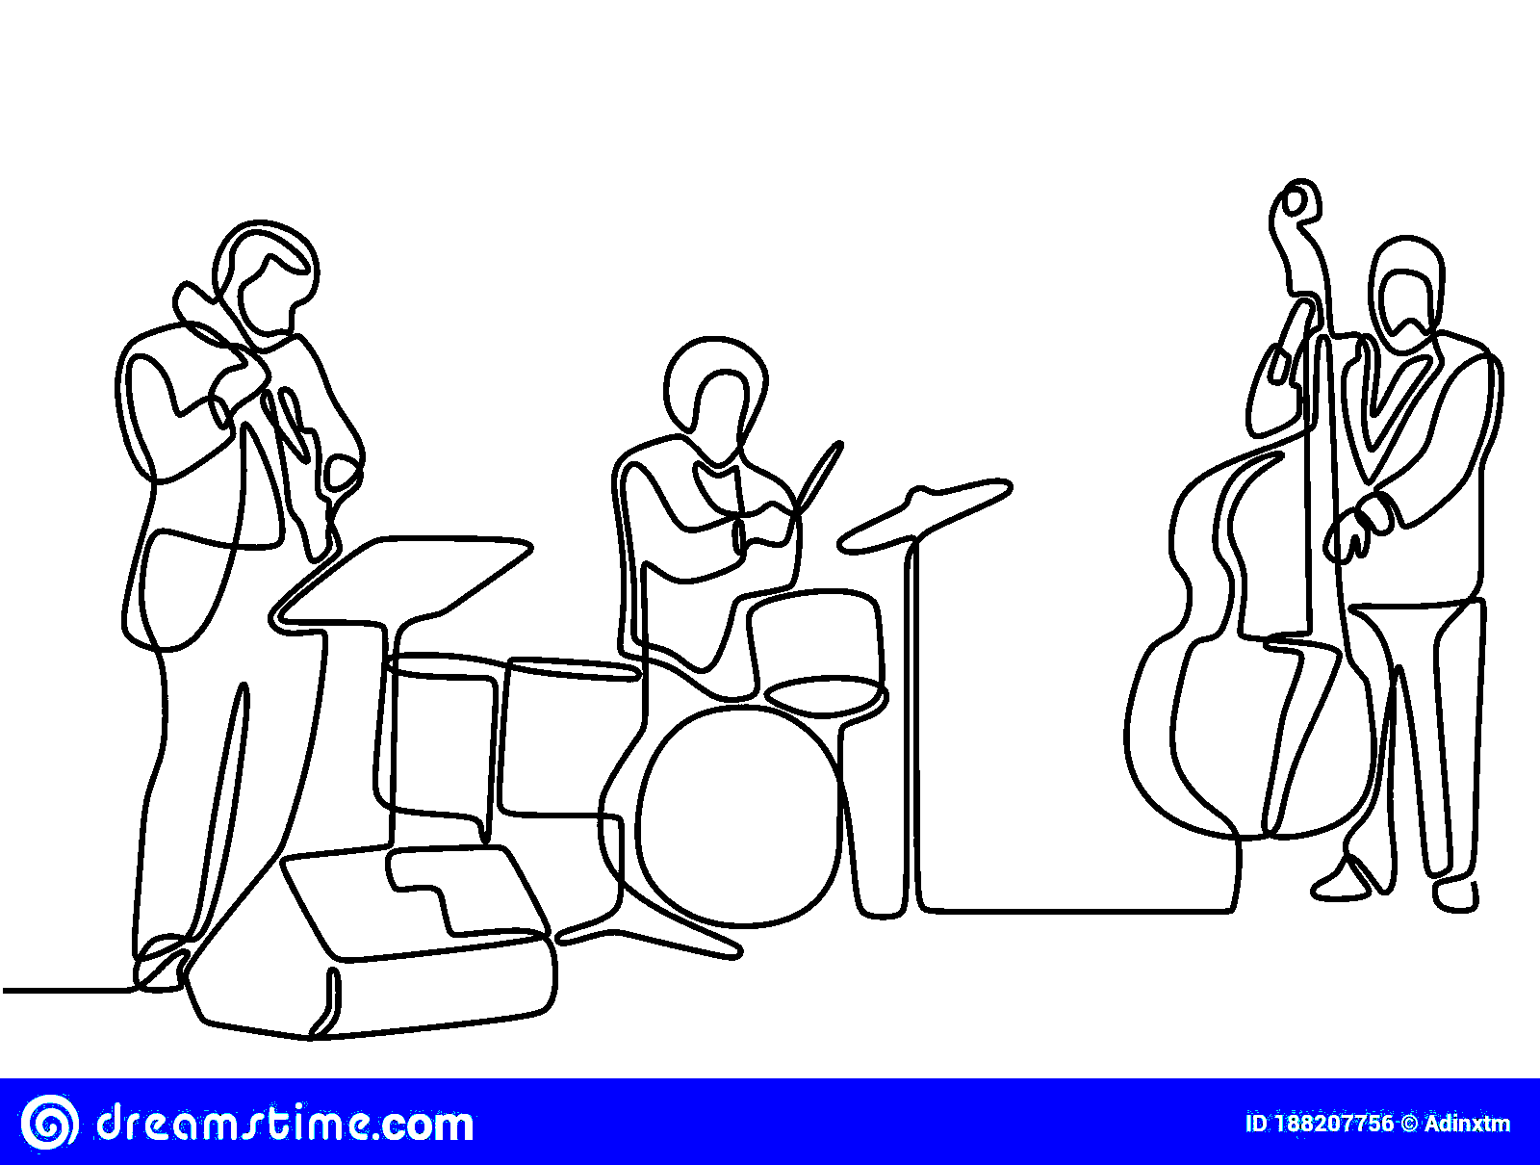
Modern Jazz Discovery Tool

Slide 2
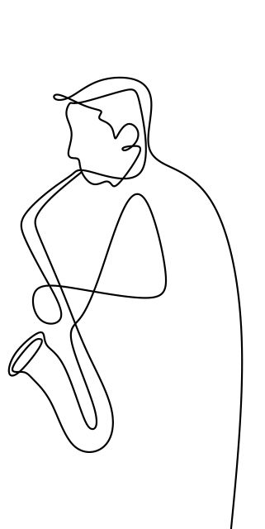
Motivations

Slide 3
Motivations
Enjoyment of DISCOVERY!

Slide 4
Motivations
Enjoyment of DISCOVERY!
How were you introduced to music you love?

Slide 5
Motivations
Enjoyment of DISCOVERY!
How were you introduced to music you love?
Music Industry Machine (Emphasizes non-jazz)

Slide 6
Motivations
Enjoyment of DISCOVERY!
How were you introduced to music you love?
Music Industry Machine (Emphasizes non-jazz)
Modern Jazz Reviews point out the connections with mainstream music - lending itself to beautiful and artistic expressions

Slide 7
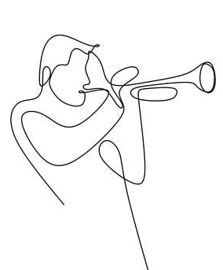
Purpose
Give mainstream (non-jazz) audiences a tool to discover Modern Jazz Music

Slide 8
Purpose
Give mainstream (non-jazz) audiences a tool to discover Modern Jazz Music
Allowing users to explore connections to music they already know and love

Slide 9
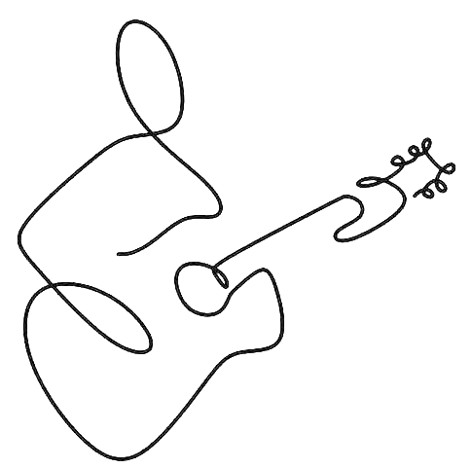
Agenda
Data & Processes
EDA
Sentiment Analysis
Topic Modeling
Audio Features
Content-based Rec System
Modern Jazz Discovery Tool

Slide 10
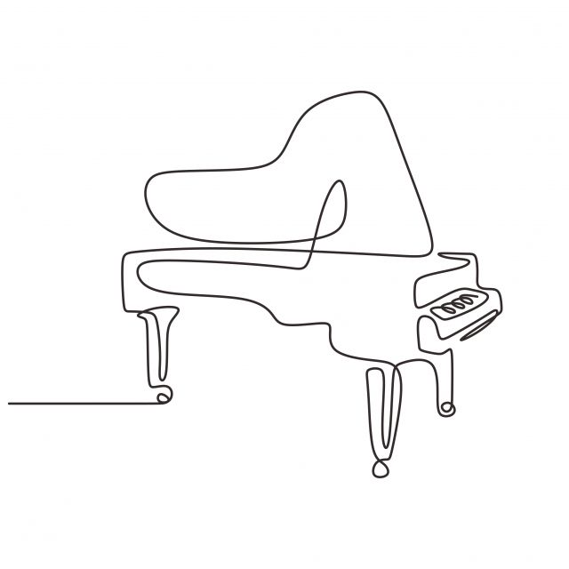
Data & Processes
Data
Pitchfork Reviews 1999-2021
Jazztimes Review (TBD)
~1,000 Jazz Reviews
Scraped using Beautiful Soup and Selenium
Spotify Audio Features
Processes
Topic Modeling (NMF)
Sentiment / Emotions
NRC Lexicon
TF-IDF – Cosine Similarity

Slide 11
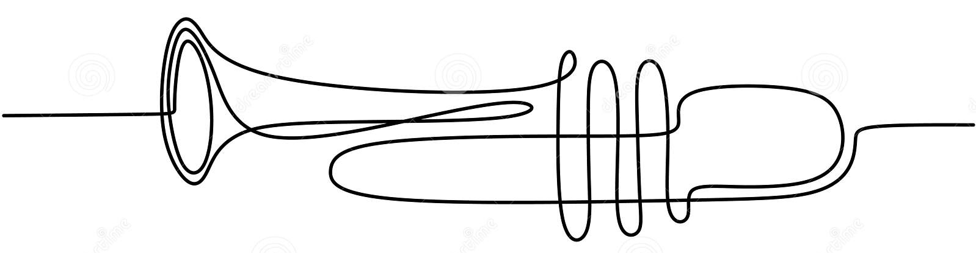

Slide 12

Sub-Genre Classifying (Phrase Matching)
“….an artist best known for soulful, worldly down tempo tries his hand at upbeat house…his melodies and live instrumentation hint at a fondness for jazz, soul, folk, and minimalism…” (Pitchfork Review of Bonobo)

Slide 13

Sub-Genre Classifying (Phrase Matching)
“….an artist best known for soulful, worldly down tempo tries his hand at upbeat house…his melodies and live instrumentation hint at a fondness for jazz, soul, folk, and minimalism…” (Pitchfork Review of Bonobo)
Down tempo
House
Jazz
Soul
Folk
Minimalism

Slide 14
Sub-Genre Classifying (Phrase Matching)
Electronic
Jazz
Blues/Soul
Folk/Country
“….an artist best known for soulful, worldly down tempo tries his hand at upbeat house…his melodies and live instrumentation hint at a fondness for jazz, soul, folk, and minimalism…” (Pitchfork Review of Bonobo)
Down tempo
House
Jazz
Soul
Folk
Minimalism

Slide 15
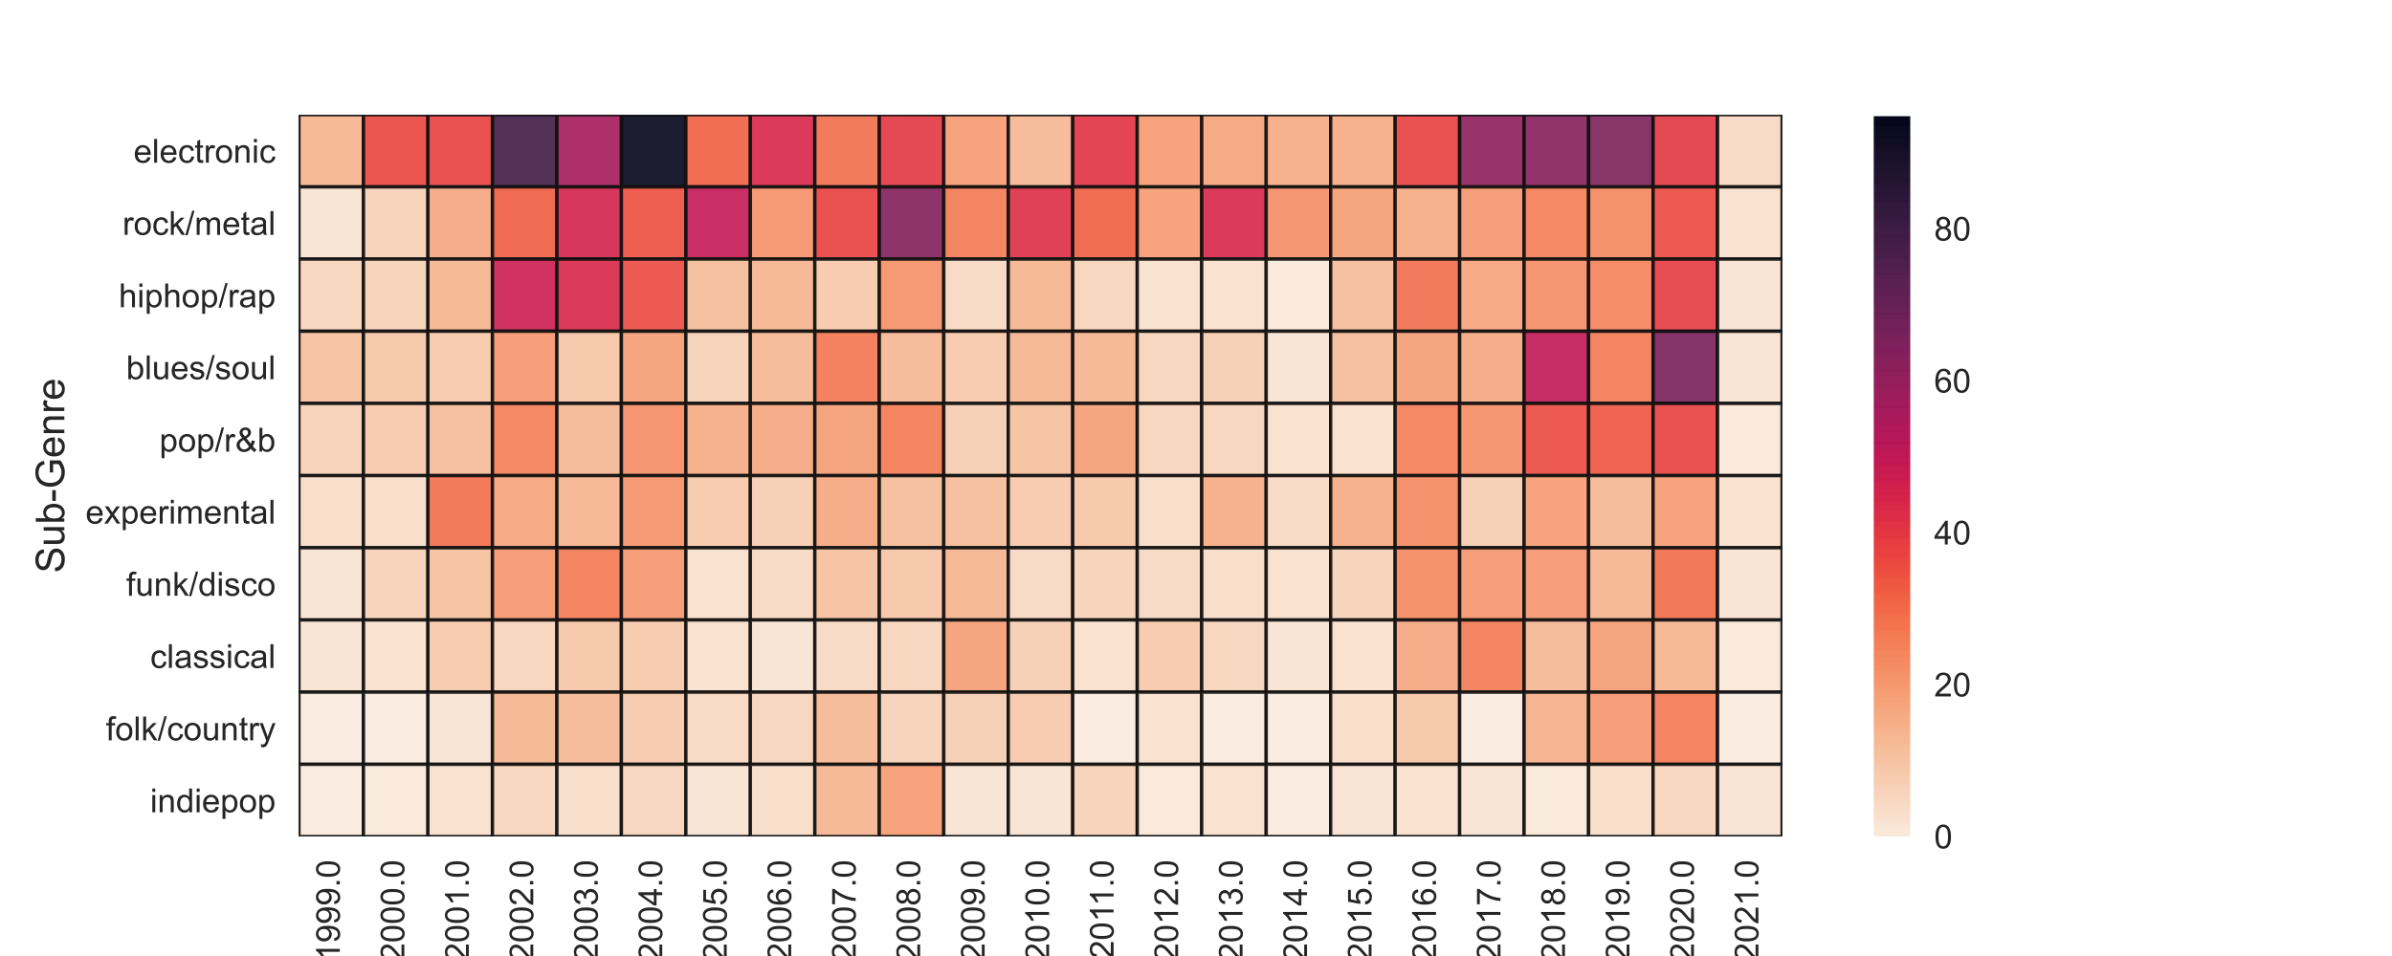
Sub-Genre Mentions Over Time

Slide 16
Sub-Genre Mentions Over Time
St Germain
Thievery Corporation
Radiohead
Wilco
Kendrick Lamar
Tyler, the Creator
Top 3

Slide 17
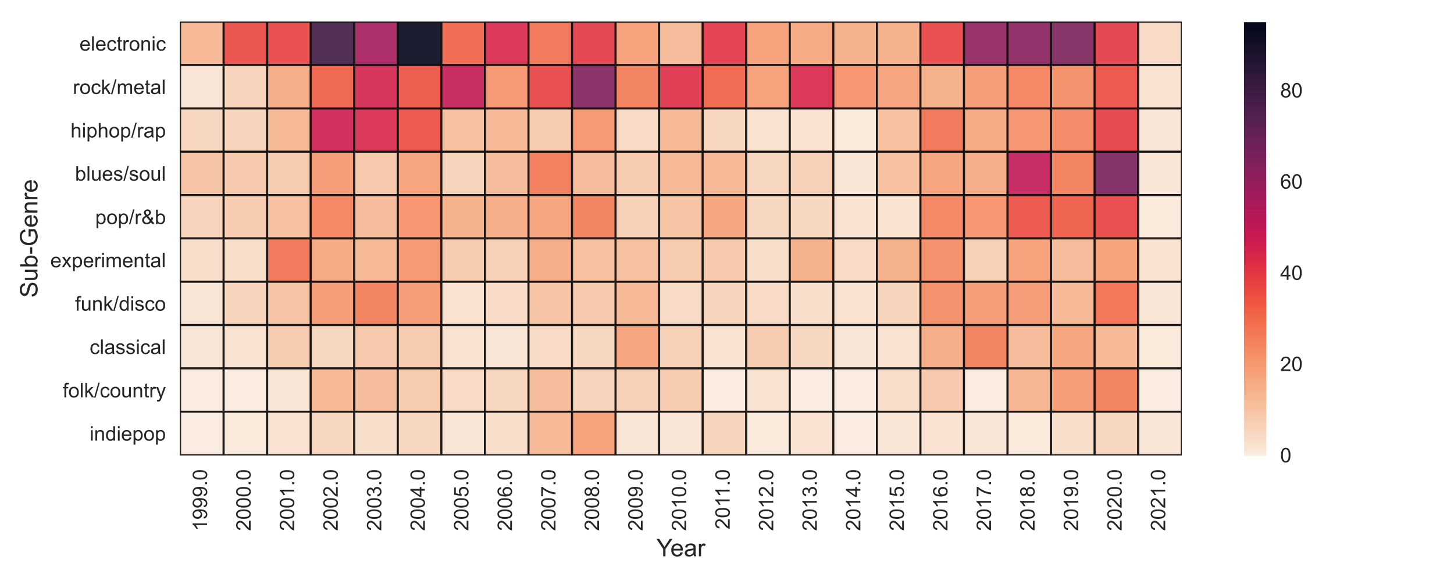
Sub-Genre Mentions Over Time
St Germain
Thievery Corporation
Radiohead
Wilco
Kendrick Lamar
Tyler, the Creator
Electronic Era
Rock Era
Hip Hop Era
Hip Hop era
“…Jazz musicians…collaborate with Kendrick Lamar; The Internet, which spun off from Odd Future…incorporates jazz elements into their music; the label Brainfeeder, purveyor of underground cool, releases jazz-tinged records from Thundercat and label boss Flying Lotus…” (https://magazine.vinylmeplease.com/magazine/why-jazz-is-suddenly-cool-again/)

Slide 18
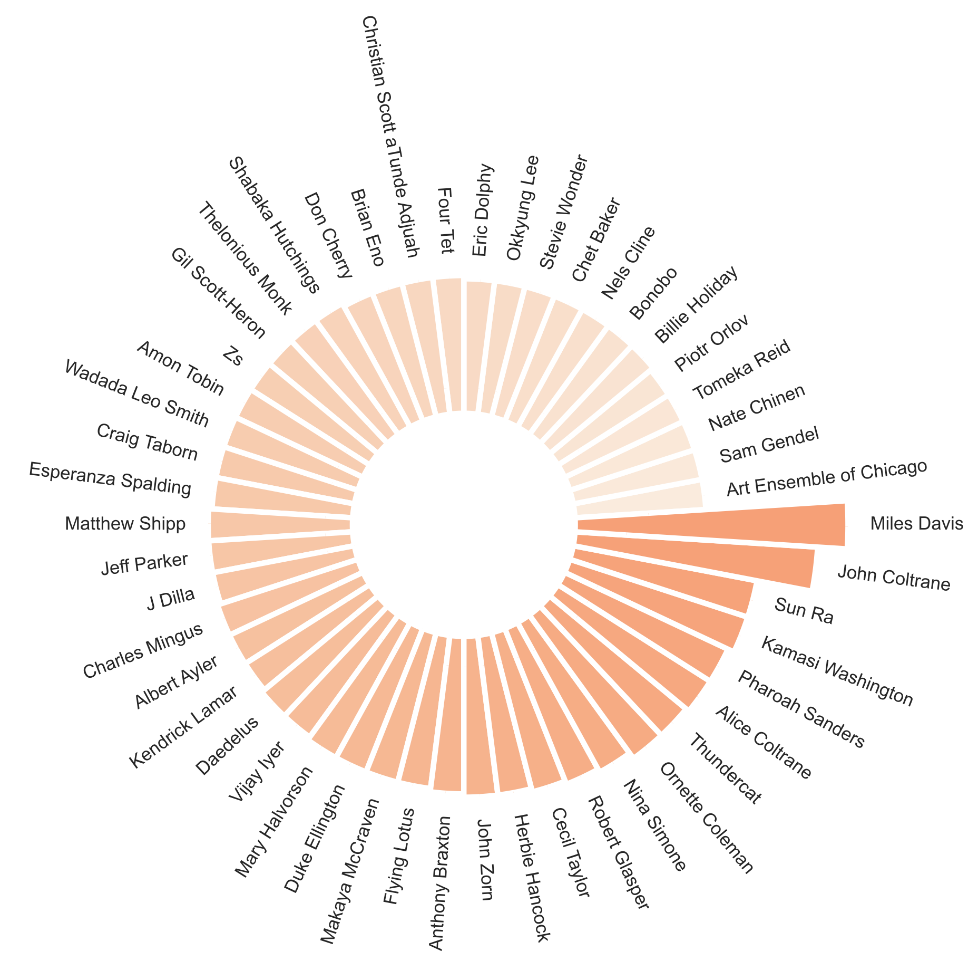
Top 60 Artists most frequently mentioned in reviews

Slide 19
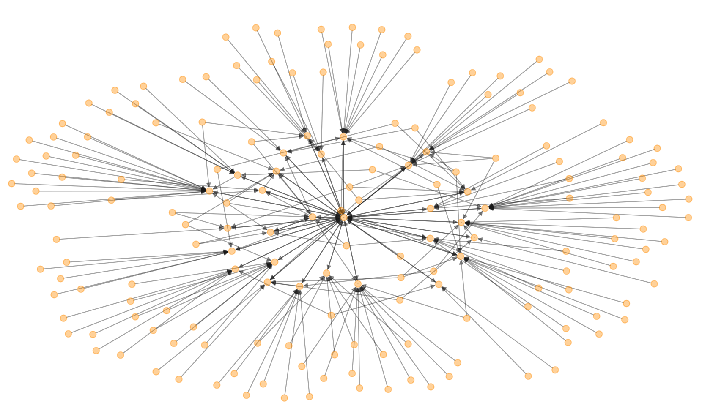
Modern Jazz Influencers (New and Old)
Peter Gabriel
Joey DeFrancesco
Beastie Boys
Miles Davis
Steely Dan
Funkadelic
Pete Rock
Robert Glasper
Kaytranada
9th Wonder
Questlove
Black Milk / Nat Turner
A Tribe Called Quest
Sonic Youth
Wilco
Danger Mouse

Slide 20
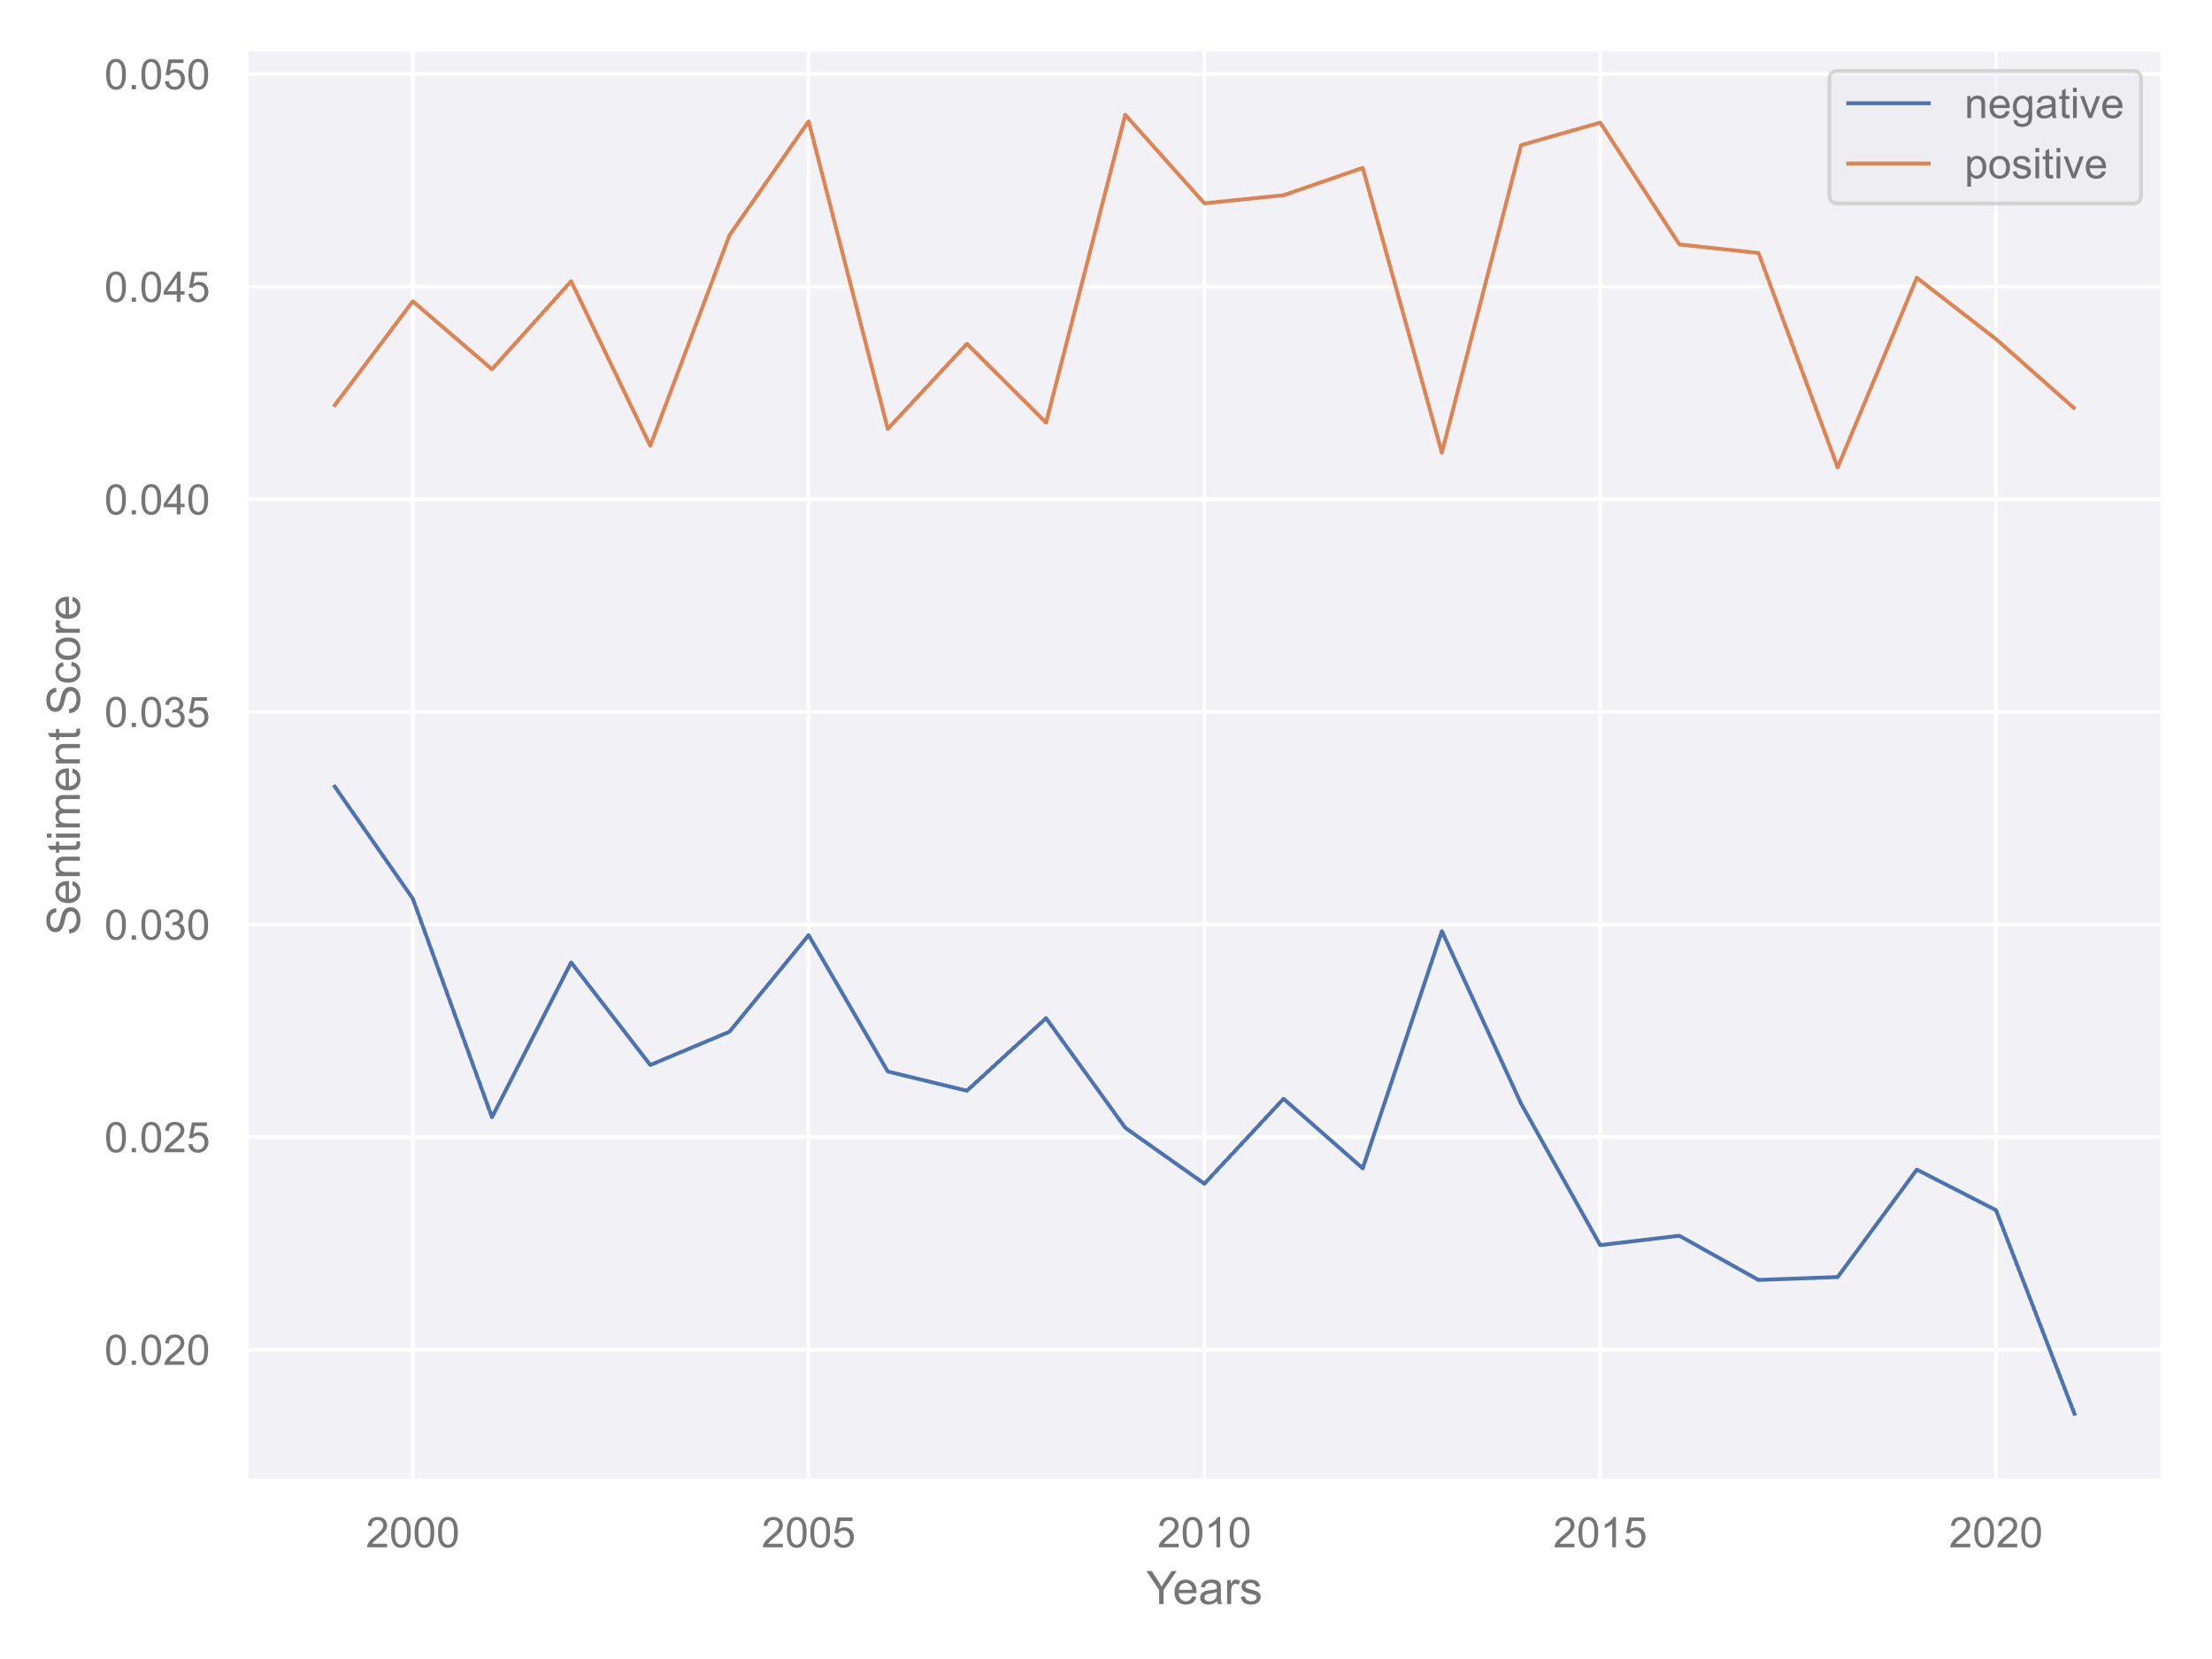
Sentiment Analysis: Pitchfork Jazz Reviews
Positive Sentiment
– no change
Negative Sentiment
– decreasing

Slide 21
Topic Modeling: Instruments
Topics
1: piano, piece, composition, quartet, trumpet, solo, melody
2: beat, hiphop, track, sample, dj, drum, mix, rap, bass, production
3: guitar, rock, sound, noise, guitarist, solo, melody, drum
4: horns, voice, singer, life, love, soul, people, day, world
5: experimental, metal, death, riff, fusion, saxophone, eye, drum
6: classic, studio, record, session, performance, version, concert, tune
7: fusion, group, member, guitarist, saxophonist, cover
8: cinematic, film, soundtrack, score, world, cut, earth, percussion
NMF Model
. Nouns Only
Min DF = 0.06
Max Df = 0.80

Slide 22
Topic Modeling: Instruments
Topics
1: piano, piece, composition, quartet, trumpet, solo, melody
2: beat, hiphop, track, sample, dj, drum, mix, rap, bass, production
3: guitar, rock, sound, noise, guitarist, solo, melody, drum
4: horns, voice, singer, life, love, soul, people, day, world
5: experimental, metal, death, riff, fusion, saxophone, eye, drum
6: classic, studio, record, session, performance, version, concert, tune
7: fusion, group, member, guitarist, saxophonist, cover
8: cinematic, film, soundtrack, score, world, cut, earth, percussion
NMF Model
. Nouns Only

Slide 23
Topic Modeling: Instruments
Topics
1: piano, piece, composition, quartet, trumpet, solo, melody
2: beat, hiphop, track, sample, dj, drum, mix, rap, bass, production
3: guitar, rock, sound, noise, guitarist, solo, melody, drum
4: horns, voice, singer, life, love, soul, people, day, world
5: experimental, metal, death, riff, fusion, saxophone, eye, drum
6: classic, studio, record, session, performance, version, concert, tune
7: fusion, group, member, guitarist, saxophonist, cover
8: cinematic, film, soundtrack, score, world, cut, earth, percussion
NMF Model
. Nouns Only

Slide 24
Topic Modeling: Instruments
Topics
1: piano, piece, composition, quartet, trumpet, solo, melody
2: beat, hiphop, track, sample, dj, drum, mix, rap, bass, production
3: guitar, rock, sound, noise, guitarist, solo, melody, drum
4: horns, voice, singer, life, love, soul, people, day, world
5: experimental, metal, death, riff, fusion, saxophone, eye, drum
6: classic, studio, record, session, performance, version, concert, tune
7: fusion, group, member, guitarist, saxophonist, cover
8: cinematic, film, soundtrack, score, world, cut, earth, percussion
NMF Model
. Nouns Only

Slide 25
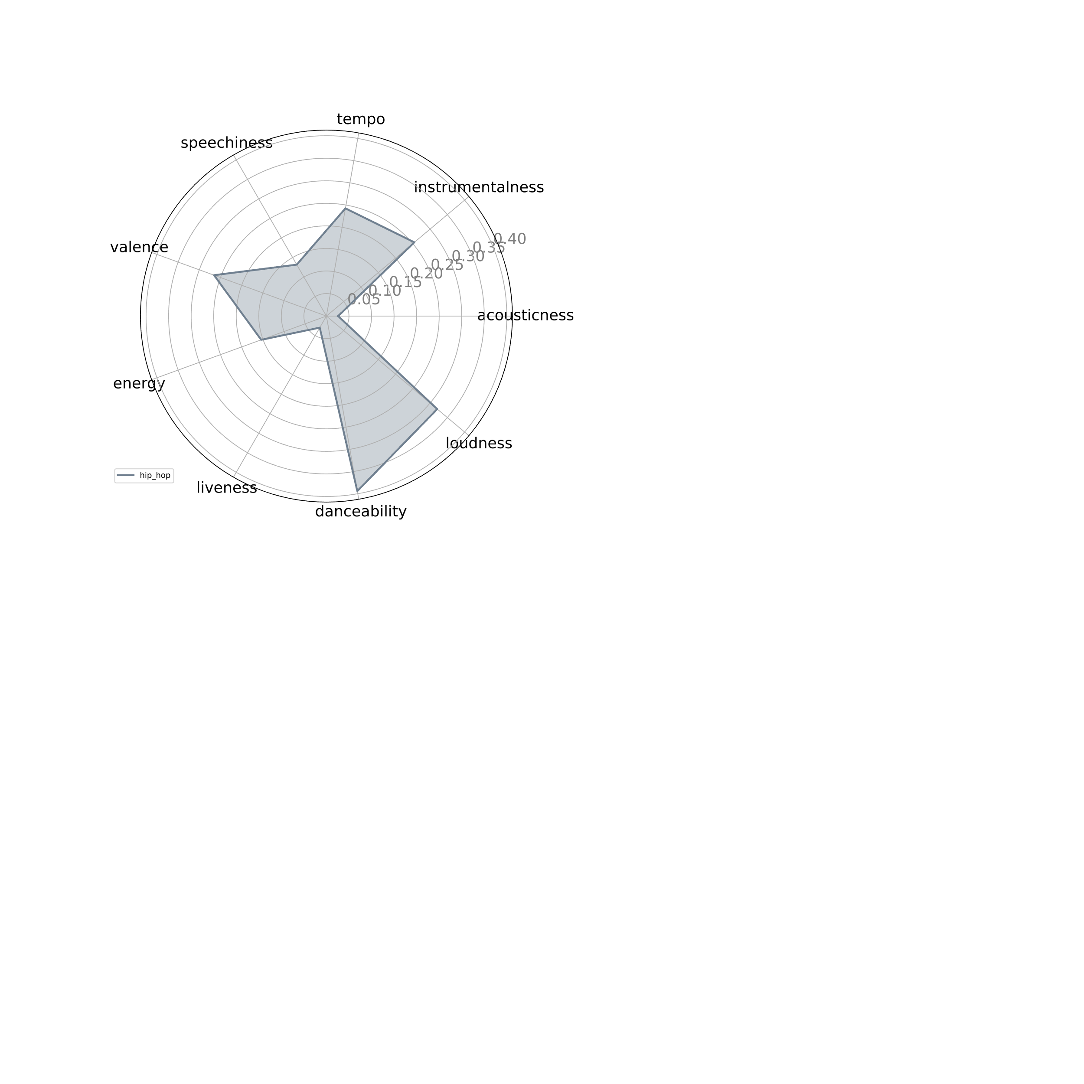
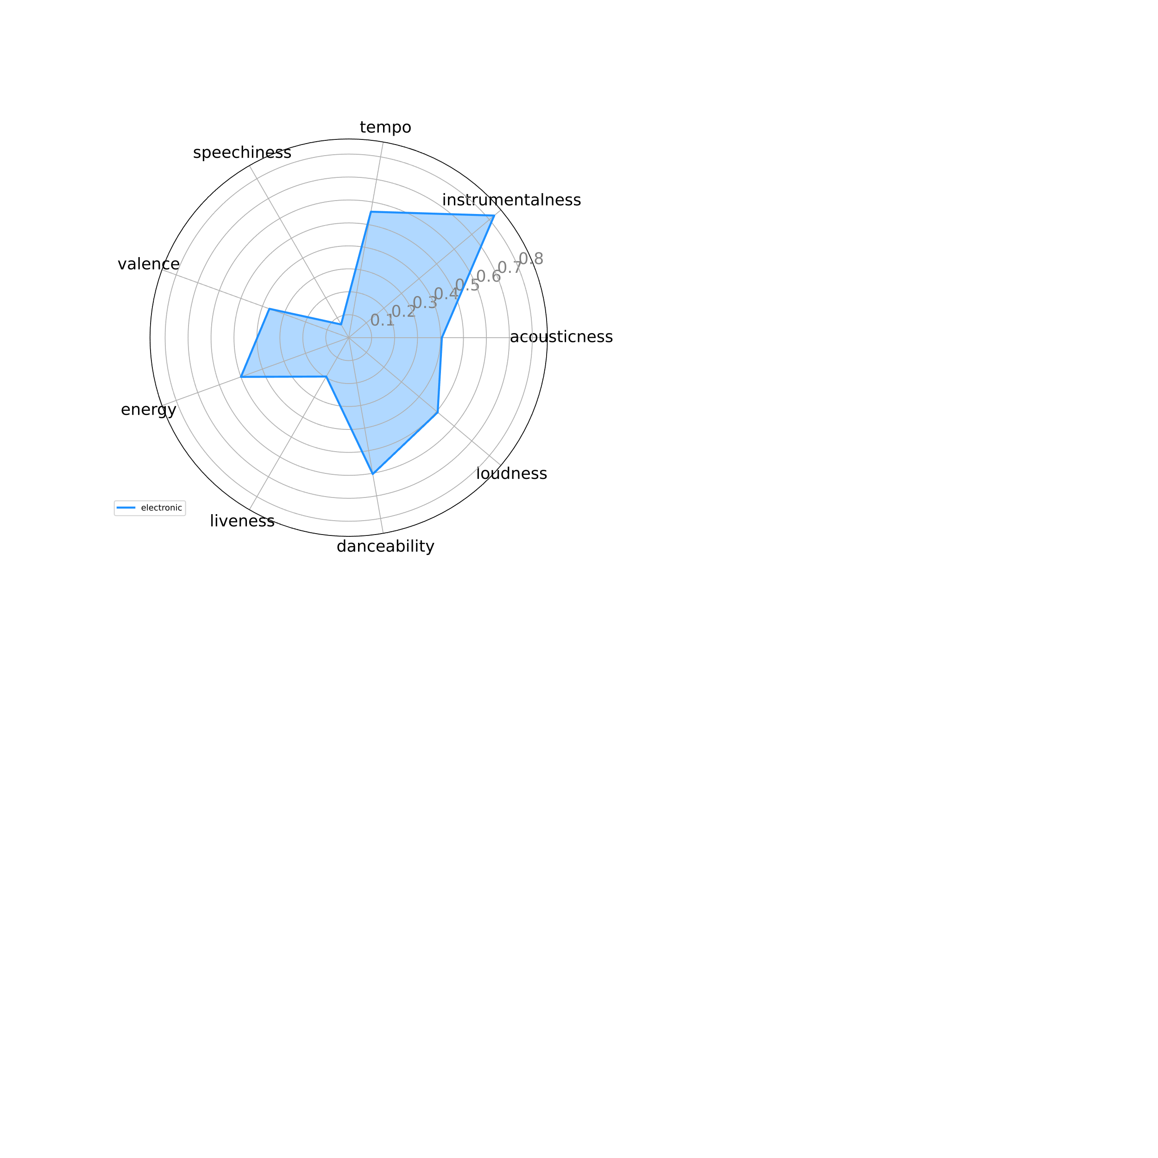
Spotify Audio Features
Rock/Metal: Yakuza (Transmutations)
Hip Hop/Rap: People Under the Stairs (O.S.T)
Electronic: Bonobo (Animal Magic)

Slide 26
Jazz Discovery Tool / Recommender (TF-IDF, Cosine Similarity)
Cosine Similarity | Album | Artist
1.000 | The Epic | Kamasi Washington
0.250 | Harmony of Difference EP | Kamasi Washington
0.201 | Heaven and Earth | Kamasi Washington
0.190 | The Choice | Kamasi Washington
0.167 | A Love Supreme: The Complete Masters | John Coltrane
0.155 | Becoming (Music From the Netflix Original Documentary) | Kamasi Washington
0.135 | Planetary Prince | Cameron Graves
0.129 | Offering: Live at Temple University | John Coltrane
0.118 | The Final Tour: The Bootleg Series | Miles Davis / John Coltrane Vol. 6
0.117 | Both Directions at Once: The Lost Album | John Coltrane
0.116 | The Complete In a Silent Way Sessions | Miles Davis
0.112 | The Bootleg Series | Miles Davis Volume 1: Live in Europe 1967
0.112 | Interstellar Space Revisited: The Music of John Coltrane | Gregg Bendian / Nels Cline

Slide 27
Jazz Discovery Tool / Recommender (TF-IDF, Cosine Similarity)
Cosine Similarity | Album | Artist
1.000 | The Epic | Kamasi Washington
0.250 | Harmony of Difference EP | Kamasi Washington
0.201 | Heaven and Earth | Kamasi Washington
0.190 | The Choice | Kamasi Washington
0.167 | A Love Supreme: The Complete Masters | John Coltrane
0.155 | Becoming (Music From the Netflix Original Documentary) | Kamasi Washington
0.135 | Planetary Prince | Cameron Graves
0.129 | Offering: Live at Temple University | John Coltrane
0.118 | The Final Tour: The Bootleg Series | Miles Davis / John Coltrane Vol. 6
0.117 | Both Directions at Once: The Lost Album | John Coltrane
0.116 | The Complete In a Silent Way Sessions | Miles Davis
0.112 | The Bootleg Series | Miles Davis Volume 1: Live in Europe 1967
0.112 | Interstellar Space Revisited: The Music of John Coltrane | Gregg Bendian / Nels Cline
Number of Mentions:
. “Coltrane”: x 8
. “A Love Supreme”: x 2
“…Washington's tenor sax solo veers off into flights of screeching intensity that were the hallmark of Coltrane…”

Slide 28
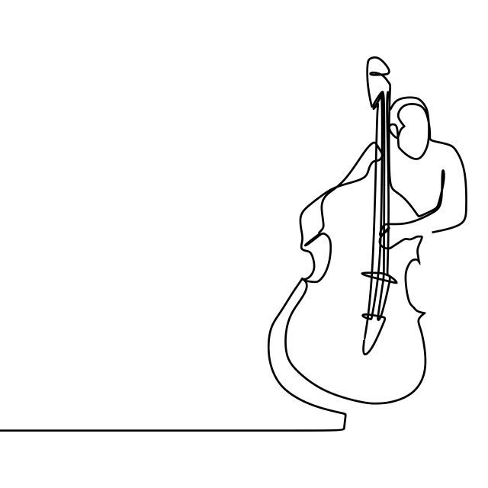
Thank You

Slide 29
Appendix

Slide 30
TO DO
Radiohead is a vector – aggregate / average – then get similiarities on that
Put 8 into a list – similarities have duplicate votes – strengthen those votes
slides
Provide Context in the slides (somehow in the app)
EDA – overview graph – jazz as a whole
. Infusion of other music into jazz as it transforms over time (how has it transformed) - heatmap
. History of transformation? Artists and quotes by 3 decades – lollipop / wordcloud?
. named entity features (mentions) – has maintained it’s roots as well as influence – network map??
. Check a few primary artists – what subgenre are they mentioned along with
. Maybe spotify (with what we have)
Reviewers
. Subgenre by EMO / Sentiment
Modeling (2 runs)
. PCA
. TF IDF
streamlit
Spotify – audio features
Artist images (last)
Artist audio snippets (last)
Cleanup app as-is
Topic modeling into the viz (instrument selection)
Emotion graph – radar-ish
Audio feature graph – radar-ish

Slide 31
. Eras, what’s the point
. Years – remove decimal
. Circle bar – highlight miles/Coltrane in different way
. Sentiment score – what’s the correct scale
. Min/max df – remove
. Radar – remove labels
. Remove rank colors in topic mod and jazz discovery lists
. Keep headers consistent
. Recommender – include album artwork
. Divider don’t use plus – use drop line
. Cutout slides @ 820
. Network graph – pick 1 or 2 and show artists
. Remove EDA from headlines
. Lots of content – show workflow of how they all come together

